Slide 1
Automata of An Elevator CSE208 D2

Slide 2
Team members:
D. Shashank - 13BCE1036
K. Gourav - 13BCE1068
M.V. Shashank - 13BCE1081

Slide 3
History
Ancient and medieval elevators used drive systems based on hoists orwinders. The invention of a system based on the screw drive was perhaps the most important step in elevator technology since ancient times, leading to the creation of modern passenger elevators. The first screw drive elevator was built by Ivan Kulibin and installed in Winter Palace in 1793. Several years later another of Kulibin's elevators was installed in Arkhangelskoye near Moscow. In 1823, an "ascending room" made its debut in London.
In 1823 in London, an "ascending room" was built and operated by two architects, Burton and Hormer. It was designed as a tourist attraction to elevate paying customers to a panoramic view of the city. The "Teagle" - a belt-driven elevator with a counterweight was developed in 1835 by Frost and Stutt in England.
On March 23, 1857 the first Otis passenger elevator was installed at 488 Broadway in New York City.
The Equitable Life Building completed in 1870 in New York City was the first office building to have passenger elevators.
The first electric elevator was built by Werner von Siemens in 1880 in Germany.
Elevator design by German engineer Konrad Kyeser (1405)

Slide 4
The hydraulic crane was invented by Sir William Armstrong in 1846 for use primarily at the docks of London for loading cargo.
Henry Waterman of New York is credited with inventing the "standing rope control" for an elevator in 1850.
In 1852, Elisha Otis introduced the safety elevator, which prevented the fall of the cab if the cable broke. The design of the Otis safety elevator is somewhat similar to one type still used today.

Slide 5
The safety and speed of electric elevators were significantly enhanced by Frank Sprague who added floor control,automatic elevators, acceleration control of cars, and safeties.
The development of elevators was led by the need for movement of raw materials including coal and lumber from hillsides.
In 1874, J.W. Meaker patented a method which permitted elevator doors to open and close safely.
In 1887, American Inventor Alexander Miles of Duluth, Minnesota patented an elevator with automatic doors that would close off the elevator shaft.
In 2000 a vacuum elevator was offered commercially in Argentina.

Slide 6
Design
An elevator is essentially a platform that is either pulled or pushed up by a mechanical means.
In the past, elevator drive mechanisms were powered by steam and water hydraulic pistons or by hand.
A modern day elevator consists of a cab (also called a "cage" or "car") mounted on a platform within an enclosed space called a shaft or sometimes a "hoistway".
Hydraulic elevators use the principles of hydraulics (in the sense of hydraulic power) to pressurize an above ground or in-ground piston to raise and lower the car.
Elevator doors protect riders from falling into the shaft.
The most common configuration for elevator door is to have two panels that meet in the middle, and slide open laterally.
In a cascading telescopic configuration for elevator door (potentially allowing wider entryways within limited space), the doors run on independent tracks so that while open, they are tucked behind one another, and while closed, they form cascading layers on one side.
Machine room-less elevators are designed so that most of the components fit within the shaft containing the elevator car; and a small cabinet houses the elevator controller.the benefits of MRL are
-creates more usable space
-use less energy (70-80% less than hydraulic elevators)
-uses no oil
-can operate at faster speeds than hydraulics but not normal traction units.

Slide 7
Postulates:
Elevator is used in different areas and aspects in our day to day life.
Due to the advancement of technology, it is said by every person in this world today that whenever a more than three storied building is seen, there should be a lift (elevator) in this building.
But this lift cannot be constructed as easy as said.
As every electronic machine works on a particular principle, even lift has an interior design and a principle that it works on.
This principle can be designed with the help of automata or the design of a lift is a derived automata.
Every lift is not associated with a human brain so that it comes and goes to whichever floor whenever we want but it is associated with an automata which helps the elevator to function in a righteous manner.

Slide 8
Assuming the initial state of the lift to be present in ground state, starting state is initialized as ground state and the number of final states as no floors. There need to be a provision such that on excess load, the automata should remain in the same state until and unless the load is decreased. There is no rule that at a time only a single input is obtained and hence the input is taken as a string. At each state different input strings are received and the strings are to be sorted in order that the lift functions properly. If the input has repeated strings, while the sorting mechanism is in action, the repetitions have to be truncated.

Slide 9
At each acceptance state, there need to be two states – one for door opening and another for door closing. At a particular state if the previous received input contains a string with states greater than that state and in that state, if another input is received with states lesser than the state itself, while sorting, the lift should consider only the states above the state and on exhausting all the states above it, then the below states should be attended in descending order sorting mechanism. At a given state, if the string doesn’t contain succeeding states, then it has to go to the preceding states in descending order. At a given state, if the current state is also present as input, it has to go to the door opening state. After a particular state is attended, the state must be eliminated from the list.

Slide 10
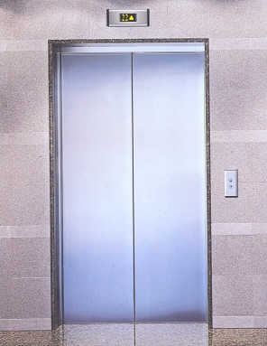
Let's imagine an elevator that serves two floors. Inputs are calls to a floor either from inside the elevator or from the floor itself. This makes three distinct inputs possible, namely: 0 - no calls 1 - call to floor one 2 - call to floor two The elevator itself can be going up, going down, or halted at a floor. If it is on floor it could be waiting for a call or about to go to the other floor. This provides us with the six states shown in figure 2 along with the state graph for the elevator controller.
DESIGNING AUTOMATA FOR AN ELEVATOR

Slide 11
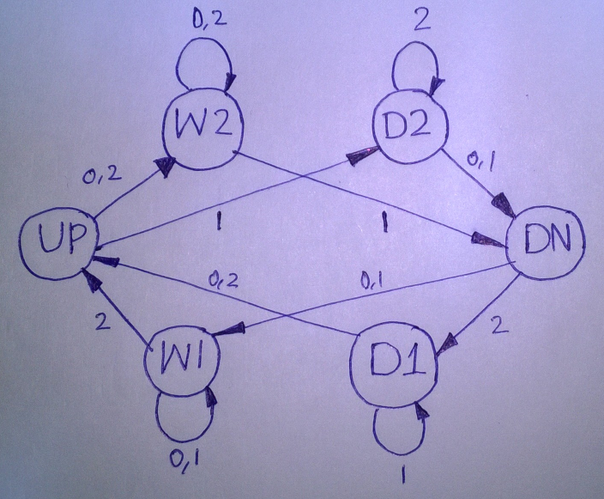
W1 Waiting on first floor
U1 About to go up
UP Going up
DN Going down
W2 Waiting on second floor
D1 About to go down from first floor
D2 About to go down from second floor

Slide 12
There are no acceptance and rejectance states because it does not makes sense unless and until issues like power failure, overloading etc. are taken into consideration.
Designing an automata of an elevator is simple but the motive of this project is to bring awareness among ourselves about the knowledge of automata to its exposure in day to day life.
This is a normal automata but a peculiar automata should be designed in such a manner that all the above stated rules are satisfied.

Slide 13
Every automata has a spring balance or a weight estimator attached to it which determines the weight of the elevator box. The elevator will be attached to an elongated wire on which the elevator moves up and down. Hence when the weight of the elevator box equals to the force due to the tension inside the string, a signal is sent that the elevator is overloaded and hence a rejectance state is set such that it does not allow the elevator to reach the door closing state unless the load is decreased.
So, to control the elevator we need three interfaces namely elevator control, elevator body and user interface.
User interface is the one which is the only thing that the user can access and is linked with the elevator control.
User interface contains buttons which give input to the elevator.

Slide 14
3
2
1
Inside the elevator
Outside the elevator
Inside the elevator there is a board of all the floor buttons each of which indicates a destination folder. Outside the elevator there are two direction buttons on each floor which call for service, one for up and the other for down except on the first and top floors in which only one button either up or down is required. Any button can be pushed at any time. Any floor button will be on from the time it is pushed until the elevator stops at the floor. Any direction button will be on from the time it is pushed until the elevator stops at the floor with the same direction. A more complex elevator will have door open and close buttons, alarm emergency button etc. which for simplicity is not considered. The basic actions of an elevator are move-up or move-down one floor, serve a floor i.e. stop at the floor, open and close the door and stay idle until further input is given. These actions are called basic because they do not mix up within themselves. For example, it is not possible to have an action as “open, move-up, close…”

Slide 15
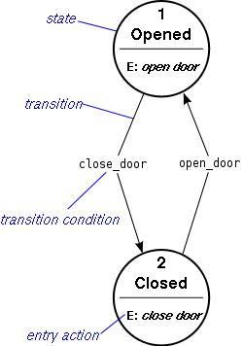
The door opening and closing states inside the elevator will be as follows:

Slide 16
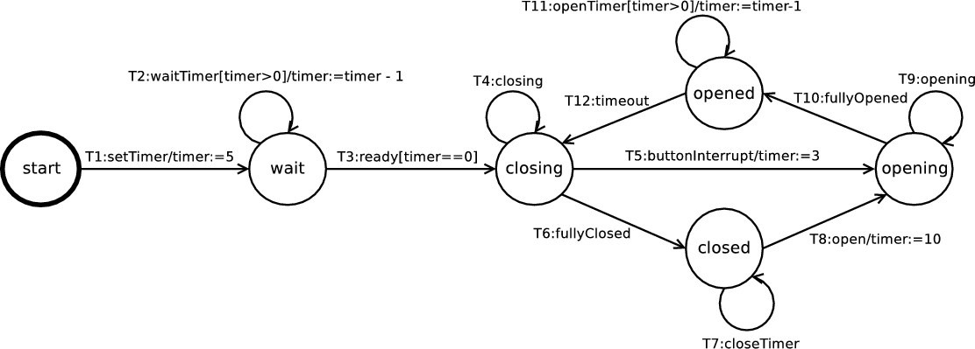
The elevator door opening and closing states outside the elevator are as follows:

Slide 17
The sorting mechanisms are also implemented using a different finite control which comes under elevator body.
The combination of all the above designs is the overall design of the elevator.
Suppose a person presses a button for the lift but later changes his mind and moves away, in order that the lift should not stop at that floor, along with up and down, let us put another button such that while leaving, if the person presses the button, the lift will ignore the input.
A C program is implemented to design an automata and find whether a string is accepted or not.

